Slide 1
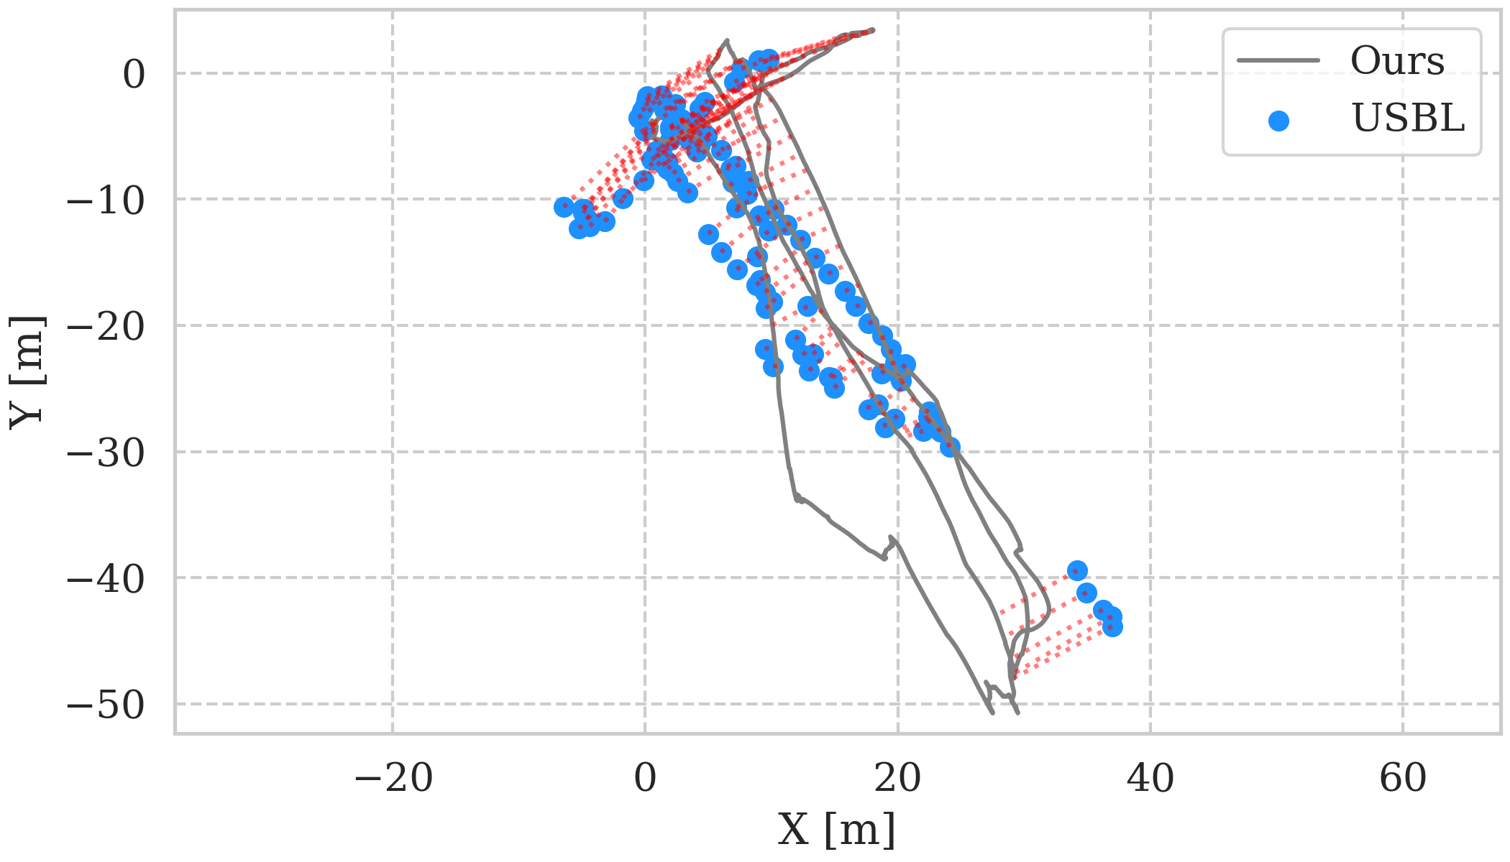
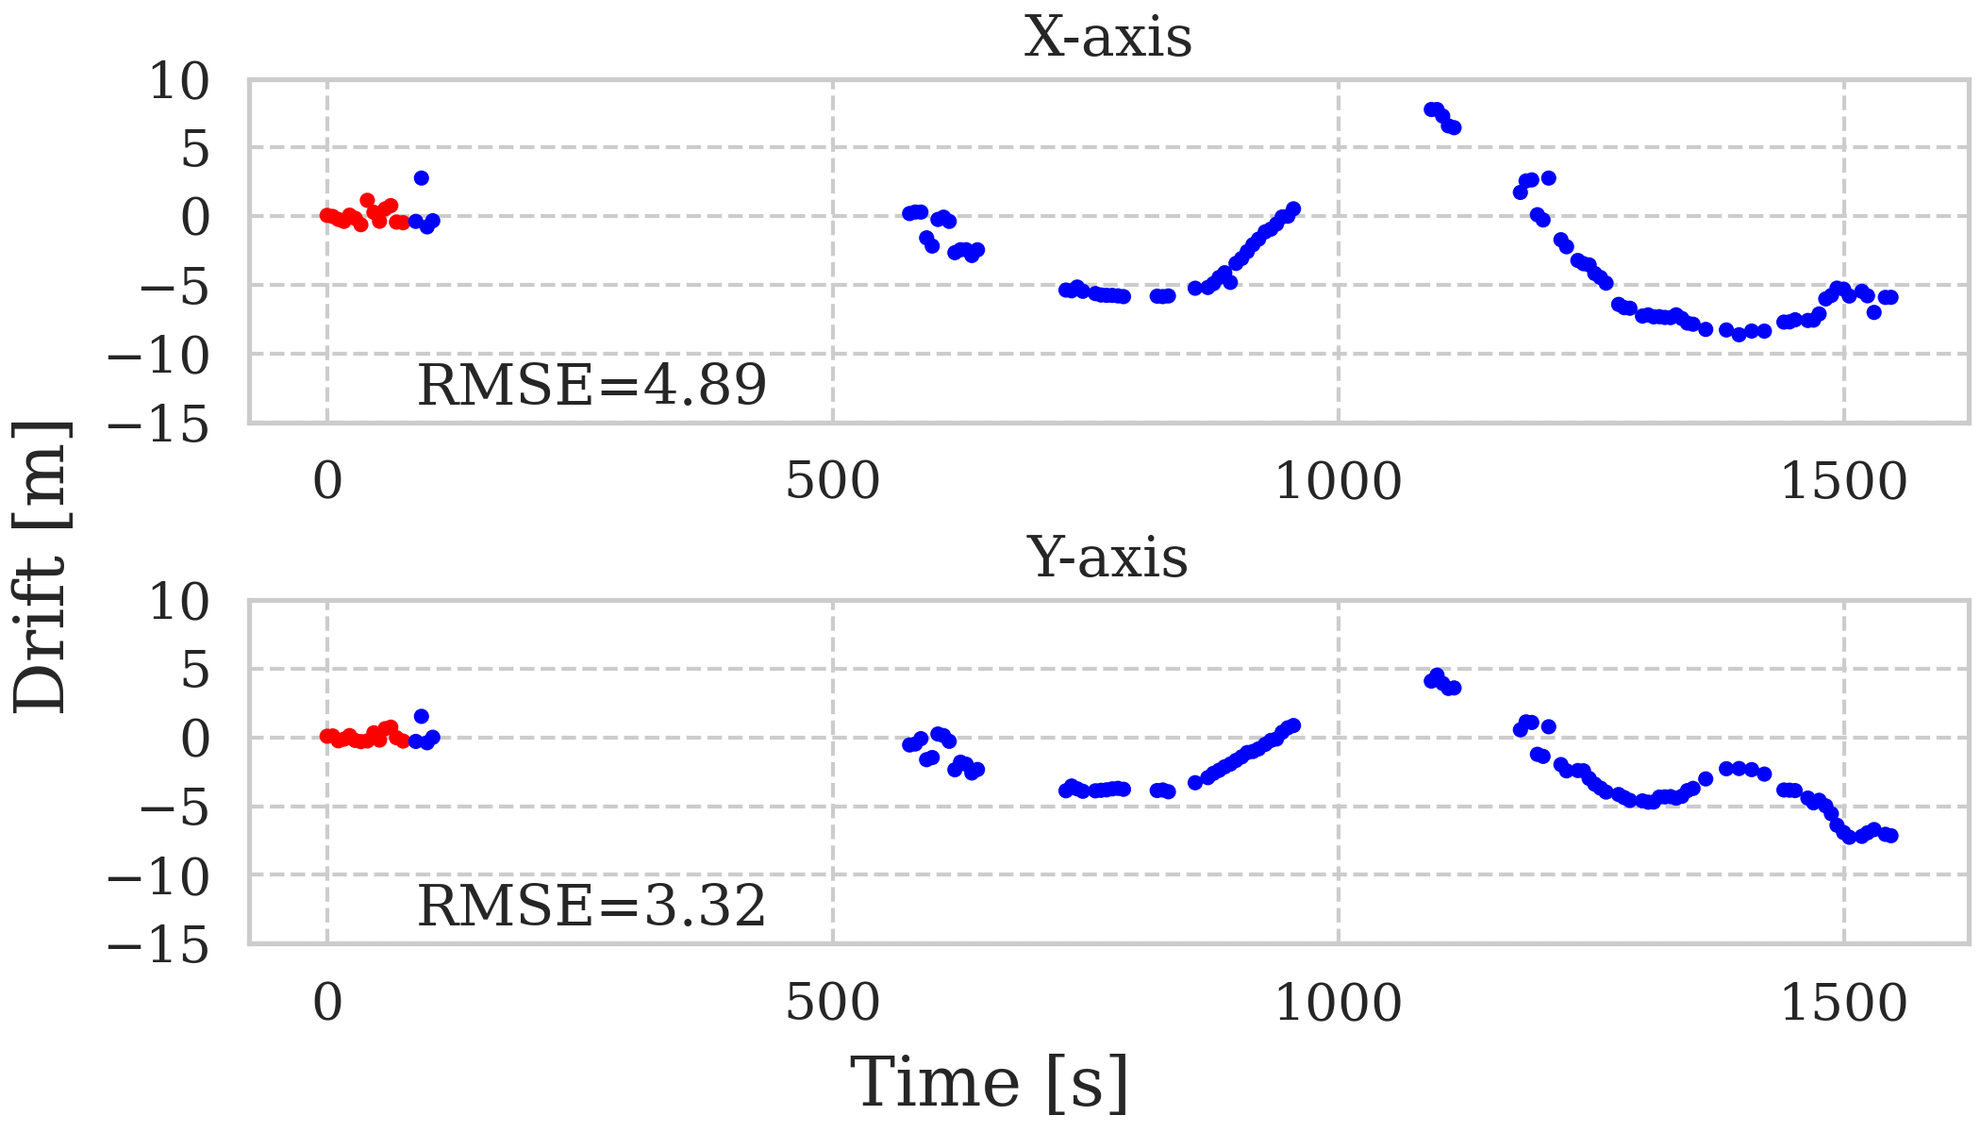
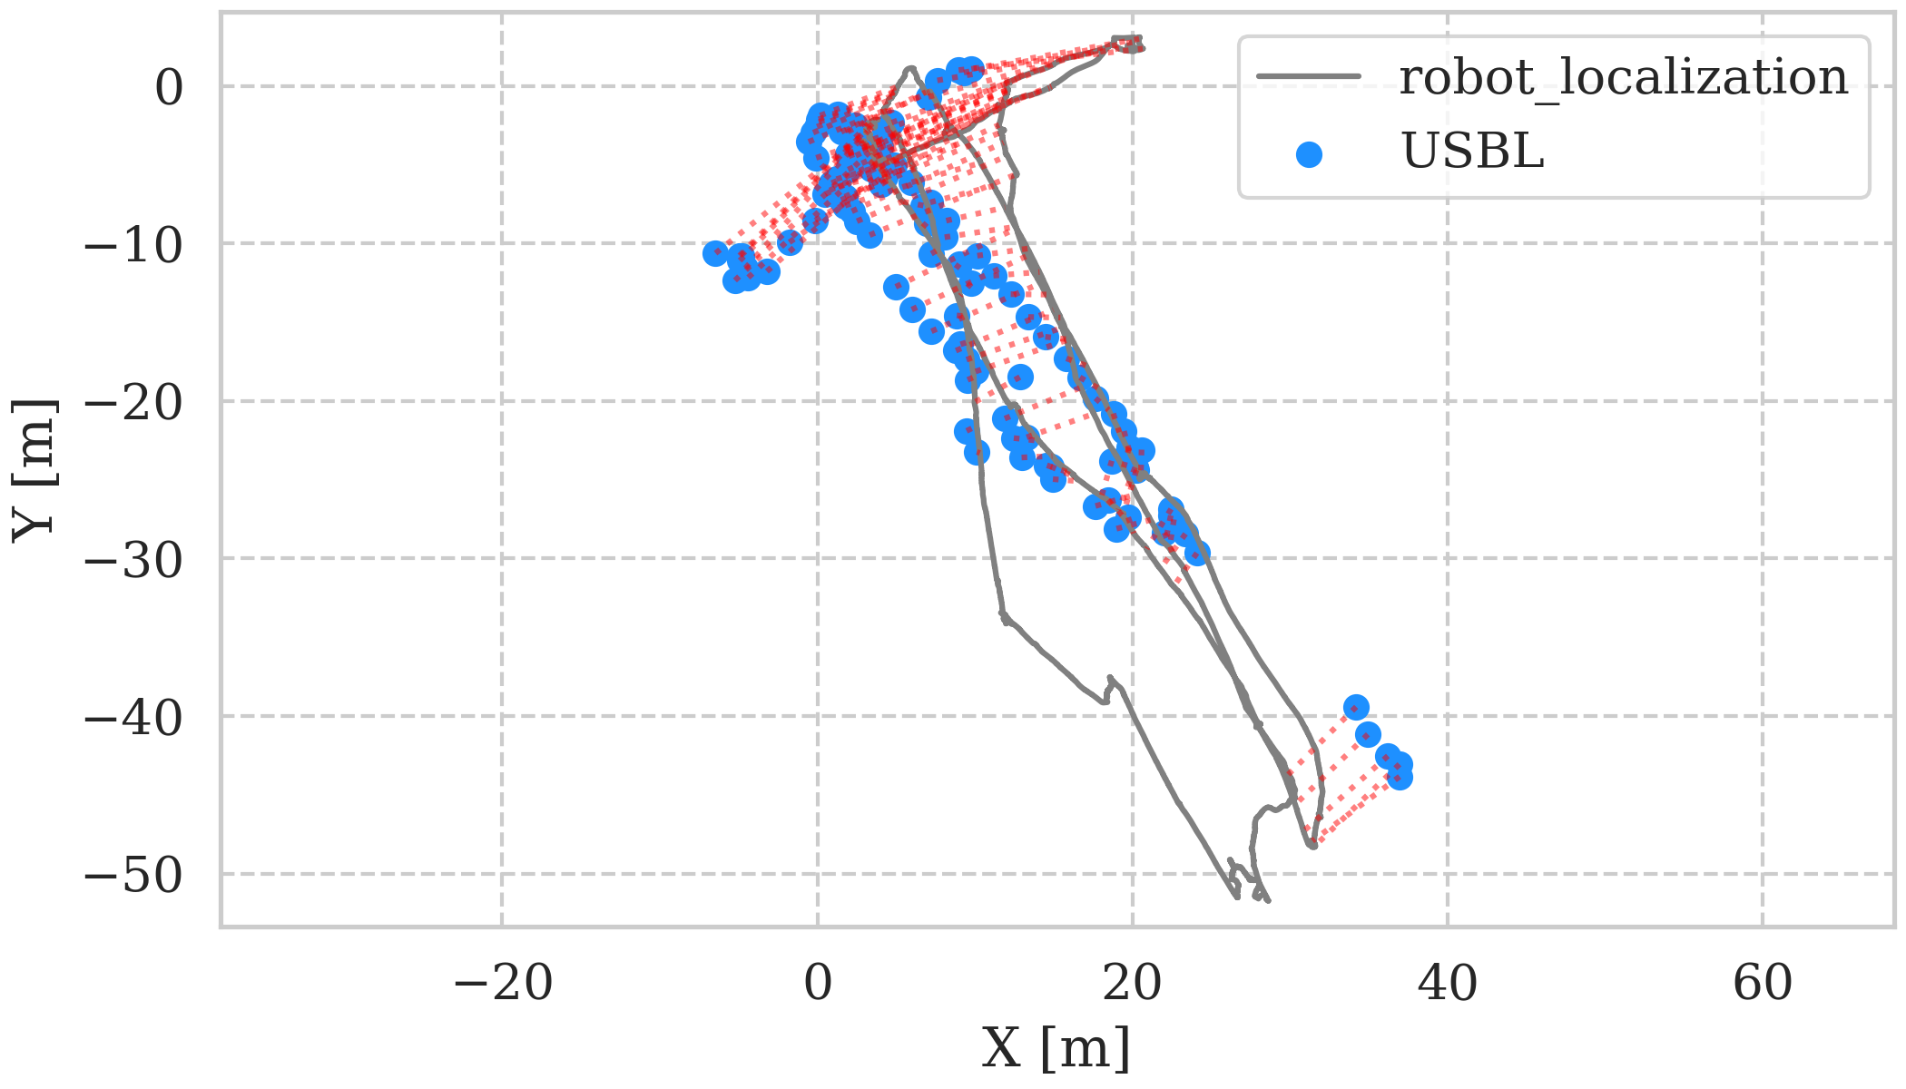
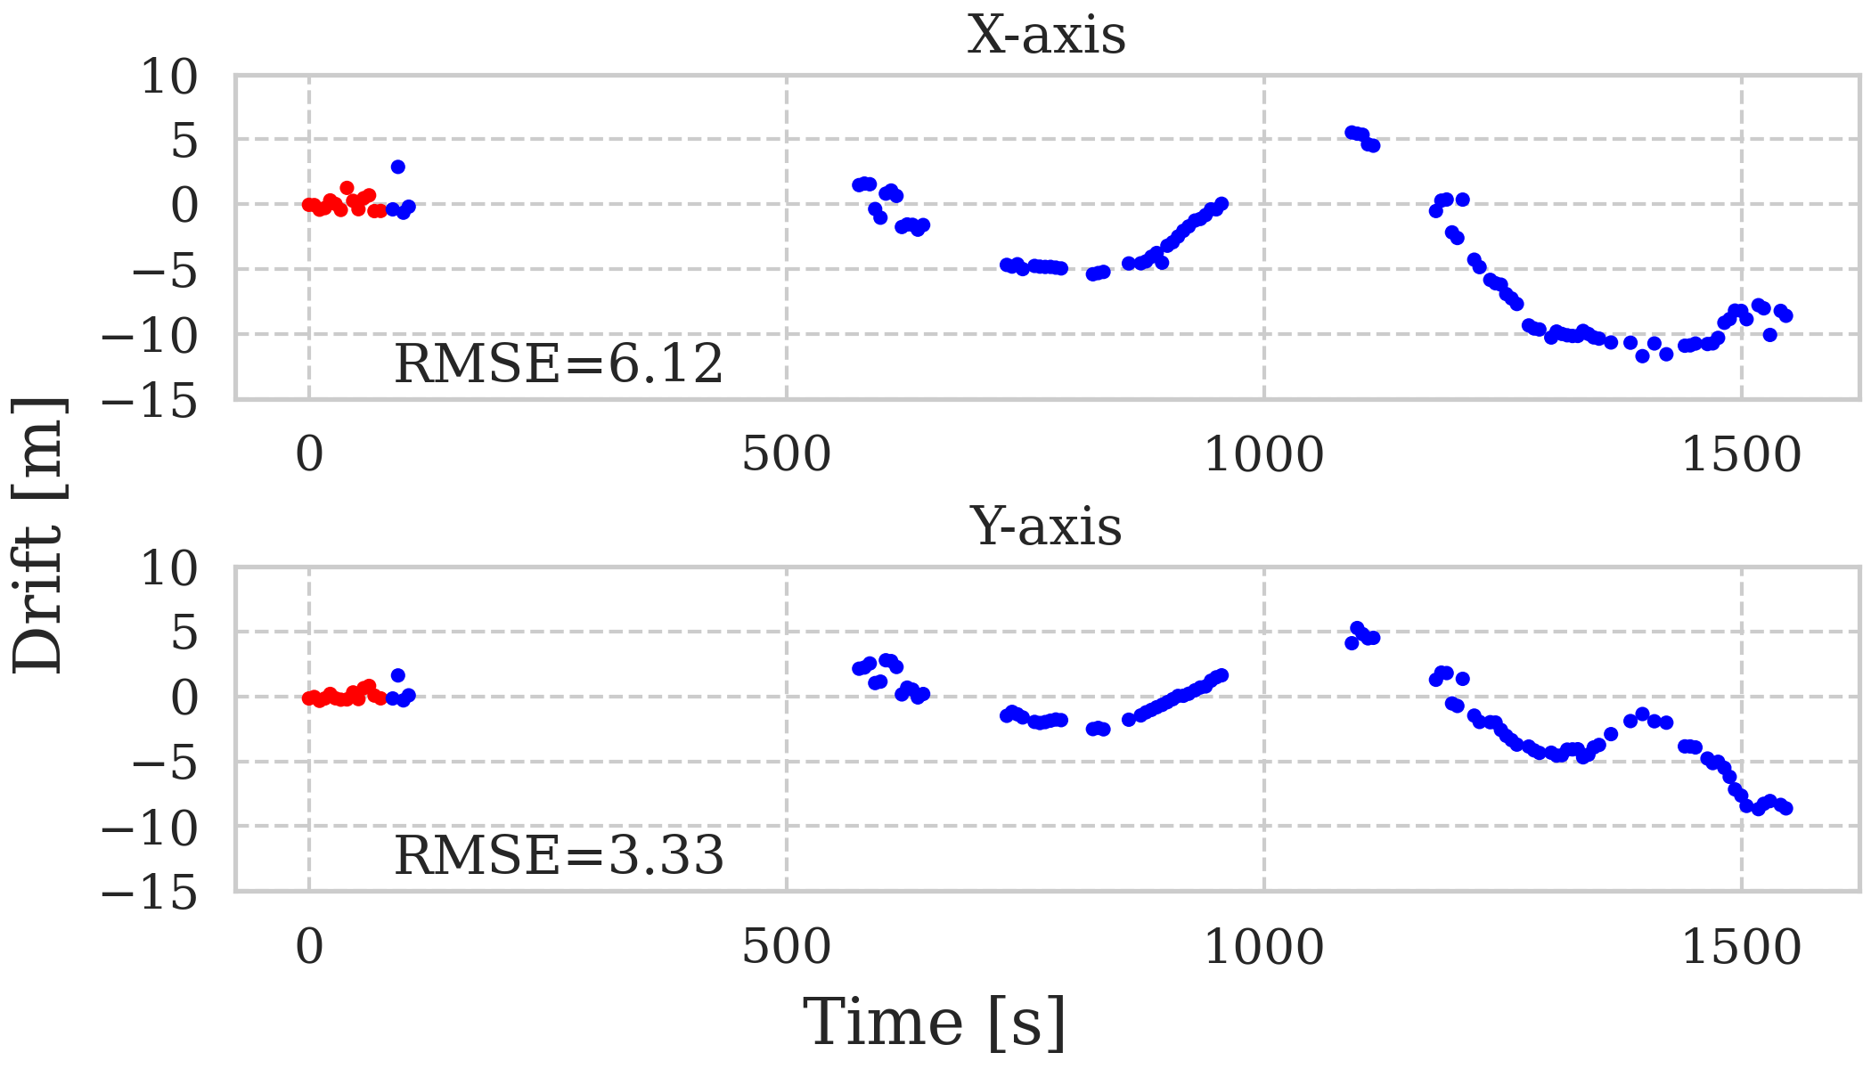
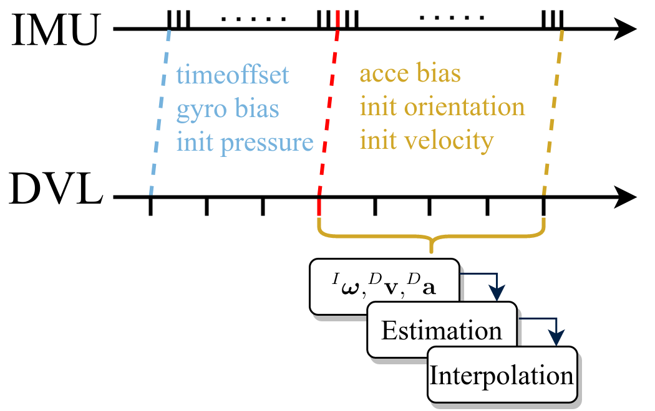
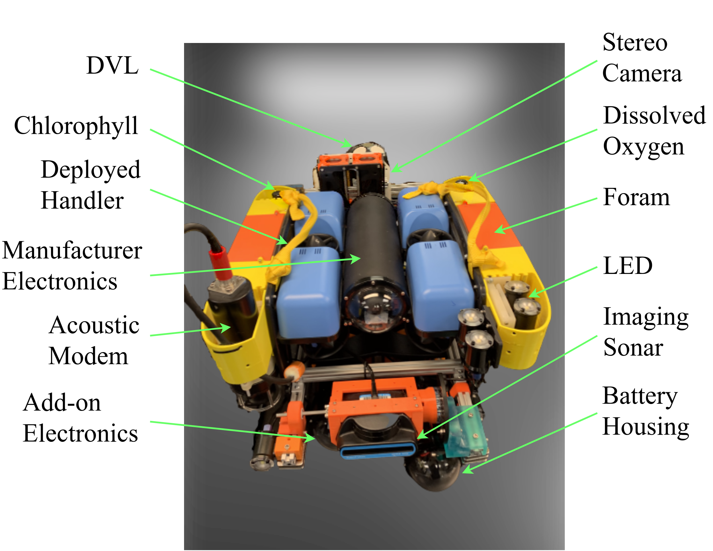
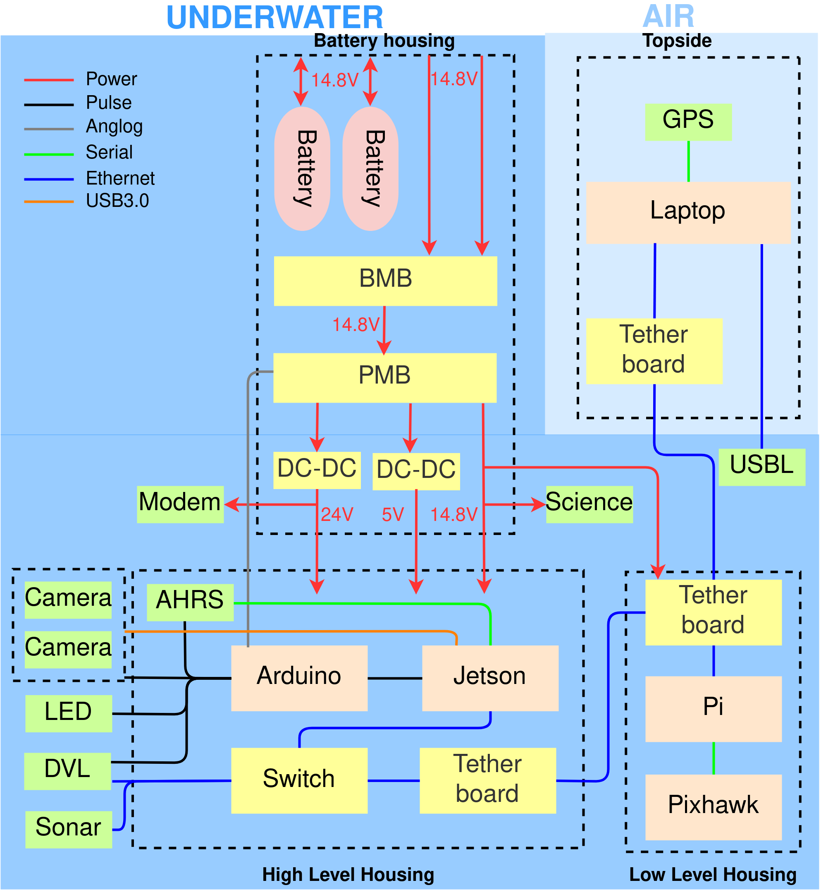
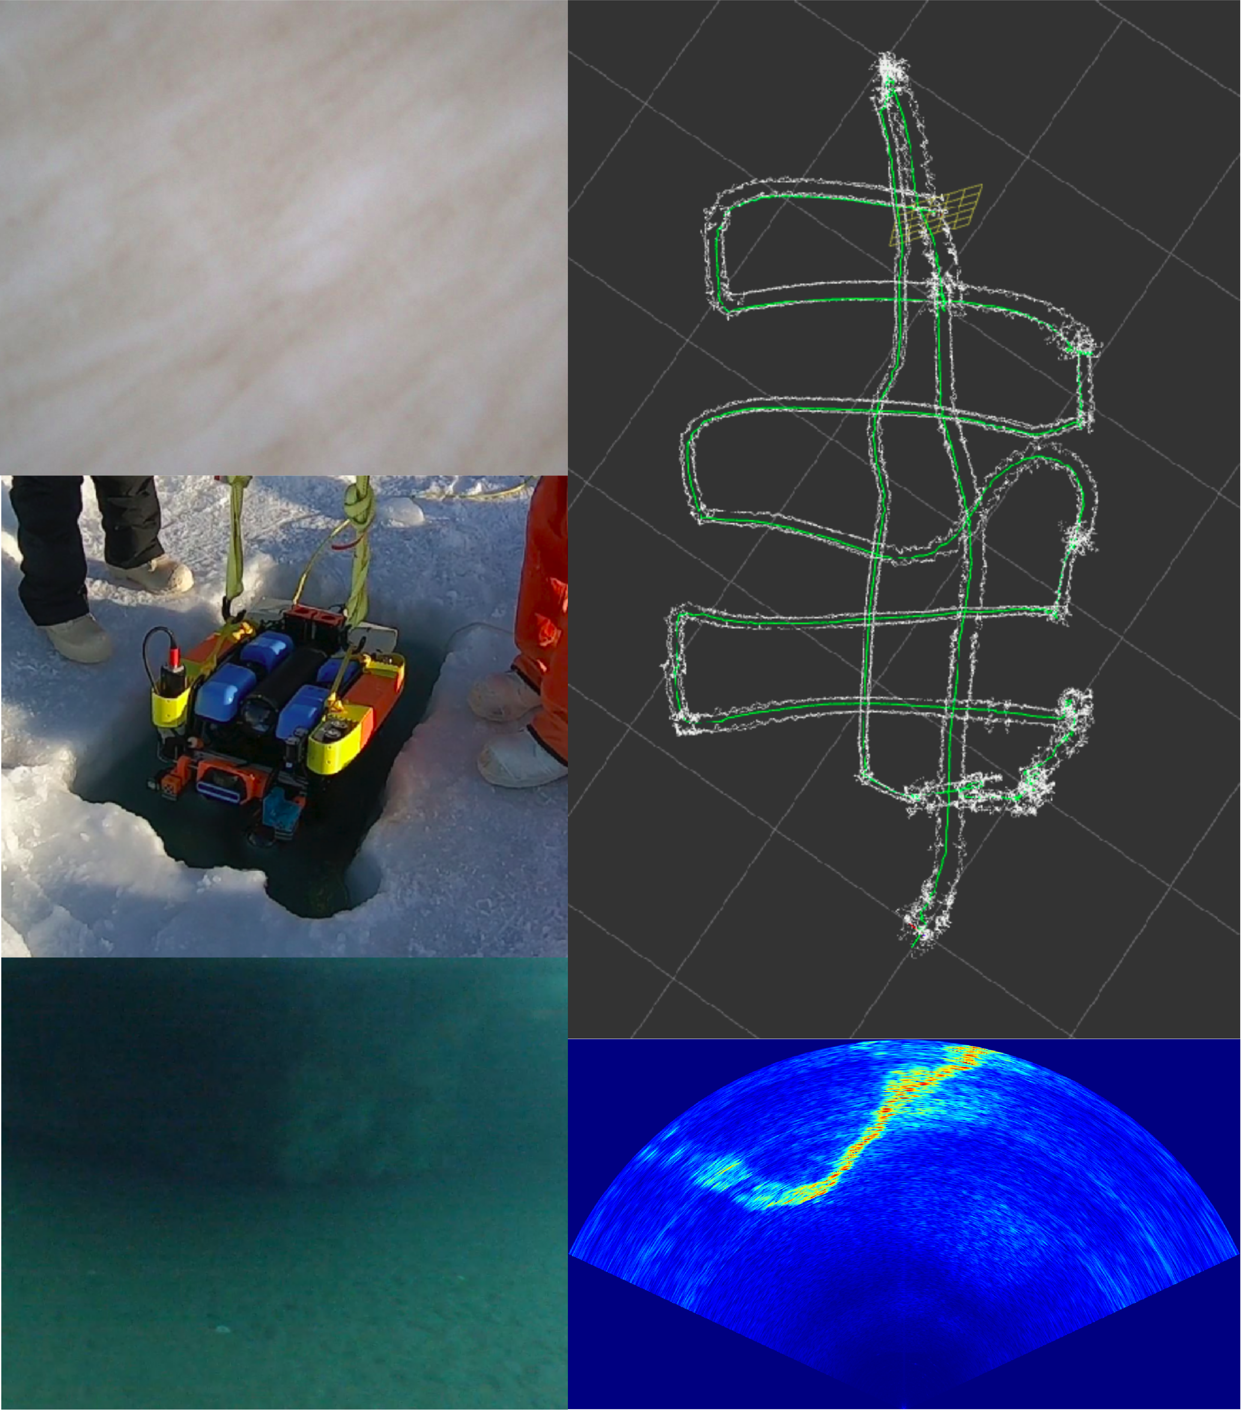
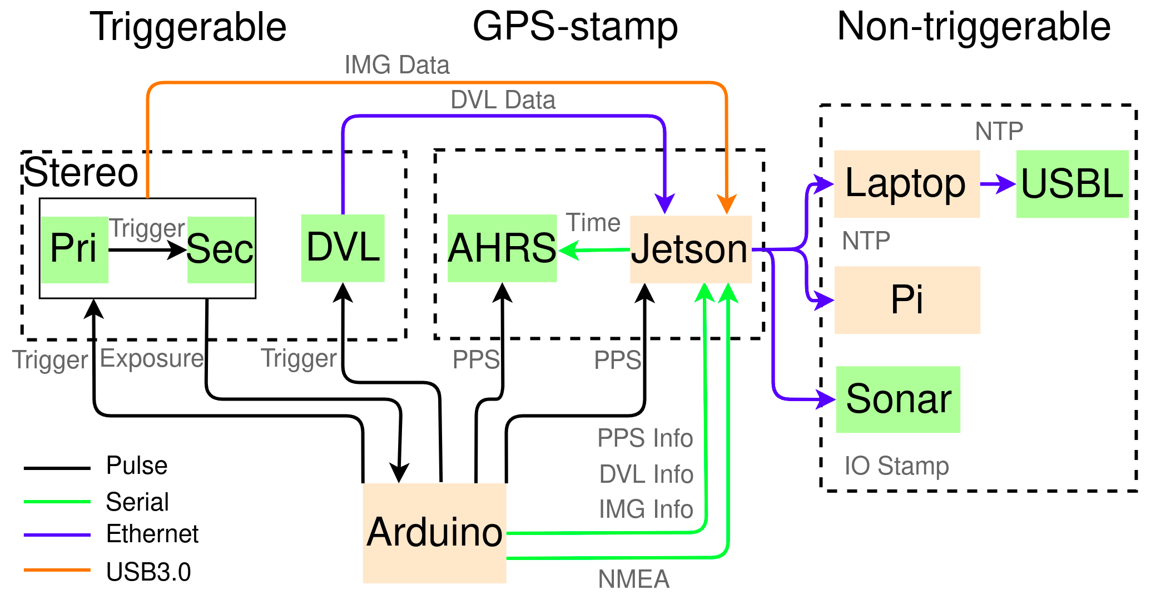
Towards Under-ice Sensing using a Portable ROV
Lin Zhao
Department of Ocean Engineering
University of Rhode Island
Abstract
Navigation Solution
B. Data Analysis
In this paper, we present our progress on developing a self-contain inertial odometry for under-ice navigation. Firstly, a microcontroller-based hardware time synchronization for multiple devices is
demonstrated. Moreover, we present a new dead-reckoning (DR) method fusing IMU, Doppler Velocity Log (DVL) and Pressure for state estimation and a robust initialization approach for underwater vehicles. Field trials have been conducted in Utqiagvik, Alaska in March 2022 to gather multi-sensor data under the sea ice. Finally, we highlight the performance of our method by comparing to the robot_localization, a widely used open-source localization algorithm.
A. Tightly-coupled Odometry
(a) our method
(a) our method
Fig. 4. EKF Digram
Keywords: Remotely Operated Vehicle (ROV),
Under-ice Navigation, Marine Robotics, Time Synchronization
B. System Initialization
Introduction & Motivation
UUVs for under-ice sampling is promising ^{[1]}
Operation logistics is complicated for large UUVs ^{[2]}
Time synchronization is important for sensor fusion ^{[3]}
Dead-reckoning is the most self-contain method and foundation of multi-sensor navigation solution ^{[4]}
(b) robot_localization
(b) robot_localization
Fig. 7. USBL fix with Estimation Trajectory.
Fig. 8. Error between USBL fix and Estimation Trajectory
Fig. 5. Initialization Diagram
Conclusion
Under-ice ROV Upgrade
A upgarded portable ROV presented for under-ice sampling including time synchronization
A novel and generalized DVL-IMU-Pressure odometry has been presented with detailed math derivation
The algorithm is evaluated by comparing to the widely used localization method, and improvement was found.
A. System Integration
Result
A. Field Operation
Future Work
Ice surface pattern image from up-looking camera
ROV deployment
Ice keel image from forward-looking camera
Online ROV trajectory
Ice keel image from forward-looking sonar
Performance online extrinsic calibration
Fuse with camera image
Fuse with sonar image
Acknowledgments
This work is supported by NSF under the award #1945924 and the Graduate School of Oceanography, University of Rhode Island. We also thank UIC Science LLC for the logistic support and ONR for the grant to participate this conference.
Fig. 1. Modified Under-Ice ROV
Fig. 2. ROV System Diagram
B. Time Synchronization
a
b
d
c
e
Reference
[1] L. D. L. Barker et al., “Scientific Challenges and Present Capabilities in Underwater Robotic Vehicle Design and Navigation for Oceanographic Exploration Under-ice,” Remote Sensing, vol. 12, no. 16, 2020.
[2] A. Spears et al., “Under Ice in Antarctica: The Icefin Unmanned Underwater Vehicle Development and Deployment,” IEEE Robotics Automation Magazine, vol. 23, no. 4, pp. 30–41, 2016
[3] F. Tschopp et al., “VersaVIS-An Open Versatile Multi-Camera Visual-Inertial Sensor Suite,” Sensors, vol. 20, p. 1439, 2020.
[4] L. Paull et al., “AUV Navigation and Localization: A Review,” IEEE Journal of Oceanic Engineering, vol. 39, no. 1, pp. 131–149, 2014.
Fig. 6. Field Operation
Fig. 3. Time Synchronization Diagram
Co-Authors: Mingxi Zhou, Brice Loose, Graduate School of Oceanography, University of Rhode Island

