Slide 1
Tightly-coupled Visual-DVL-Inertial Odometry for Robot-based Ice-water Boundary Exploration
Lin Zhao†, Mingxi Zhou‡, Brice Loose‡
†Department of Ocean Engineering
‡Graduate School of Oceanography
University of Rhode Island
Notes:
Hi, my name is Lin Zhao, I am a Ph.D. student from Department of ocean engineering , University of Rhode Island
Today, I am gone present our paper: “********”
Nowadays, Visual-aided method becoming popular for underwater scenario since it has high resolution environment observation
For the ice-water interface, close range between vehicle and ice make the optical camera possible to provide self-contained navigation solution

Slide 2
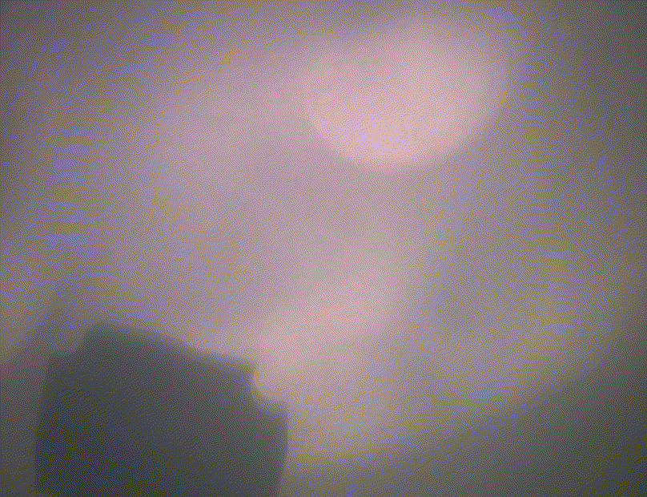
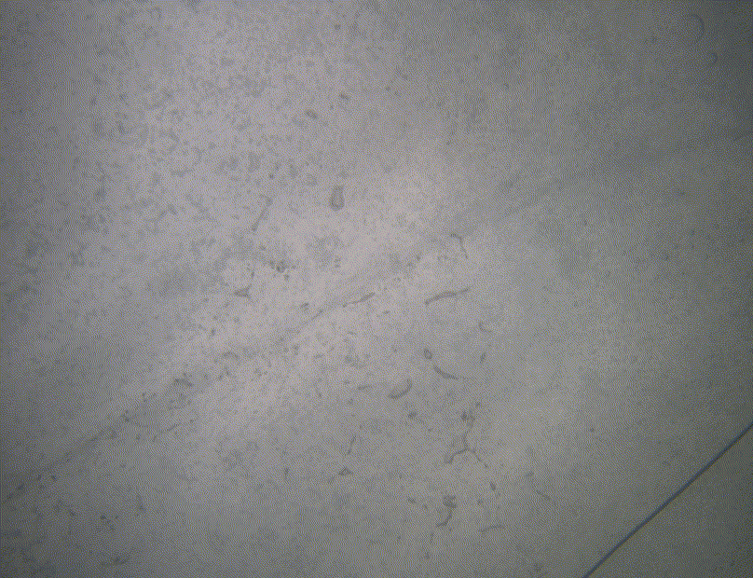
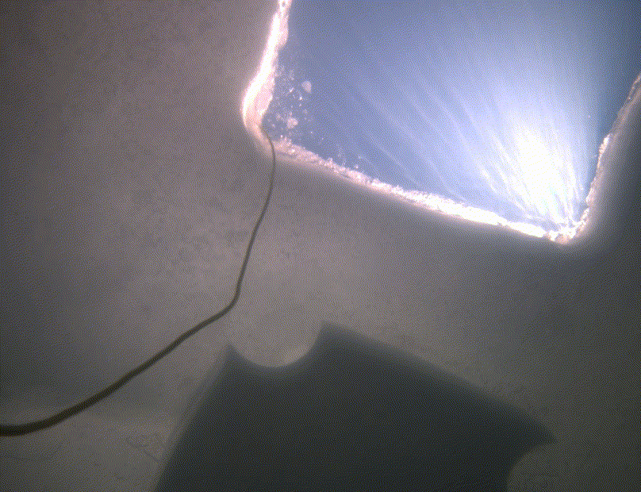
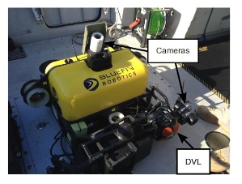
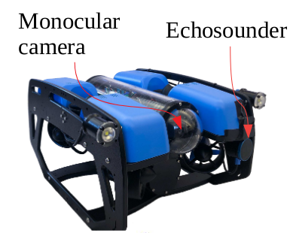
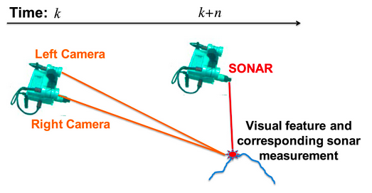
Introduction:
(a) Low speed cruise
& feature-less area
(b) Long-term hovering
(c) Dynamic illumination
(d) Stereo and MSIS fusion ^{[1]}
(e) DVL plane feature and
Visual feature constraints ^{[2]}
(f) Echosounder enhance visual
feature estimation ^{[3]}
[1] S. Rahman et al., "SVIn2: A multi-sensor fusion-based underwater SLAM system," The International Journal of Robotics Research. 2022
[2] P. Ozog and R. Eustice, "Real-time SLAM with piecewise-planar surface models and sparse 3D point clouds," IROS, 2013
[3] M. Roznere and A. Q. Li, "Underwater Monocular Image Depth Estimation using Single-beam Echosounder," IROS, 2020.
2
Notes:
However, degenerative motion and Challenging image conditions hinder the performance of visual-based method
Because of that, researchers been working on visual measurements intergrated with other sensors to bring robust localization
…

Slide 3
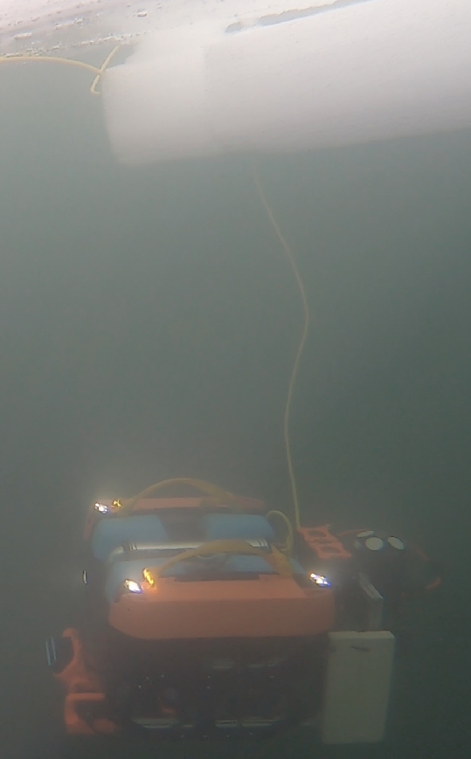
Contributions:
A modified keyframe marginalization to improve the valid feature update
A DVL point cloud aided feature enhancement
Underice dataset validation
3
Notes:
Based on our previous IMU-DVL-Pressure fused odometry
For the degraded under-ice environment, we propose to use onboard DVL non-uniform and sparse point cloud to enhance the feature estimation.
And the contributions are including:

Slide 4
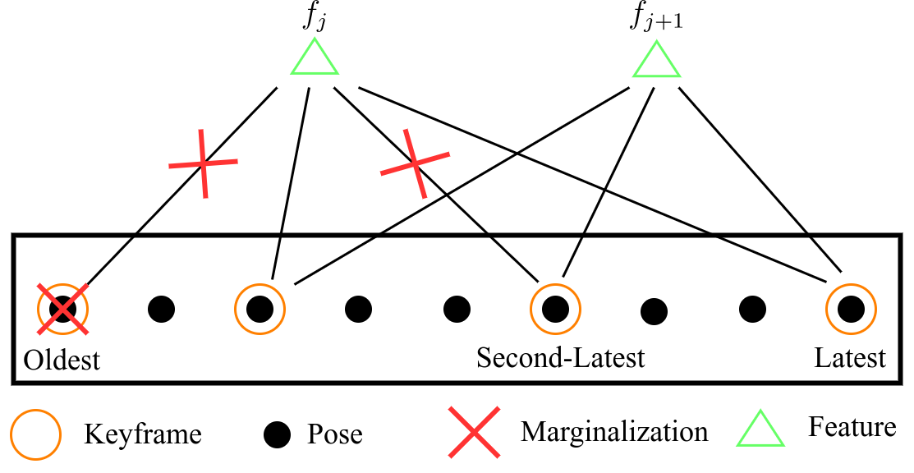
Keyframe Marginalization Modification:
Insert keyframes based on motion and scene constraints:
improve triangulation performance
Marginalize the oldest pose & features from oldest and second-latest:
each feature update will provide relative large constraints
4
Notes:
We use the standard MSCKF for the feature update with two modifcations

Slide 5
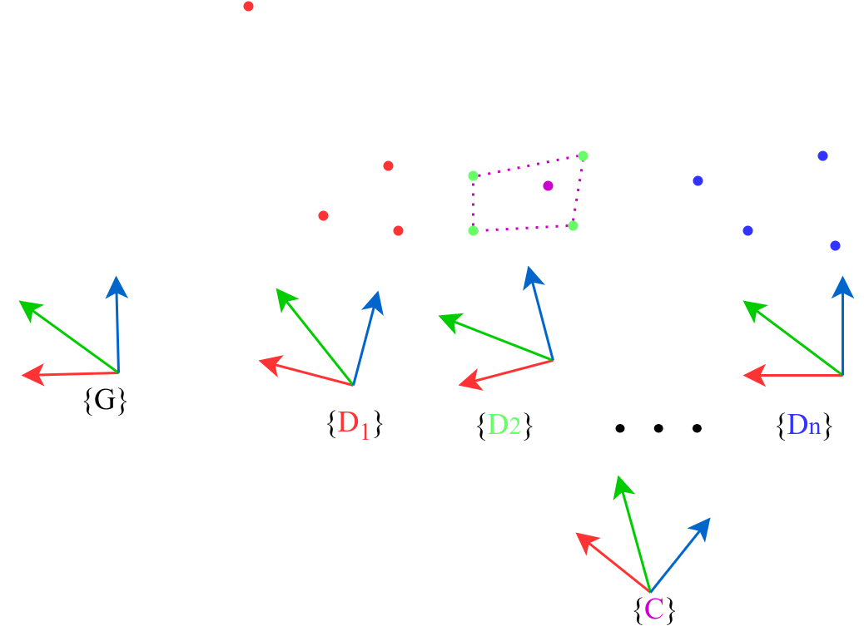
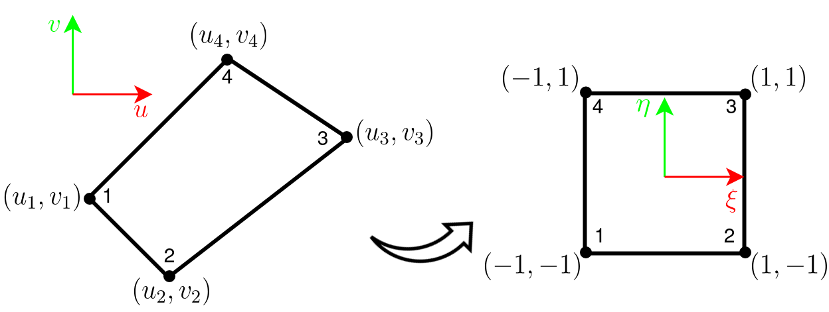
DVL-aided Feature Enhancement:
For each DVL point cloud from n selected frames:
Transfer to global frame
Filter multi-path caused by ice-opening
Transfer to normalized camera 2D plane
Check if feature inside arbitrary quadrilateral
(a) DVL and Visual matching
Convert arbitrary quadrilateral to a square
Bilinear interpolation on the feature position for the depth
Apply the rescale ratio to enhance feature
(b) Depth Bilinear interpolation on on an arbitrary quadrilateral
5
Notes:
For the DVL-aided feature enhancement
First of all, we do the DVL and visual matching:
Then we do the depth interpolation:

Slide 6
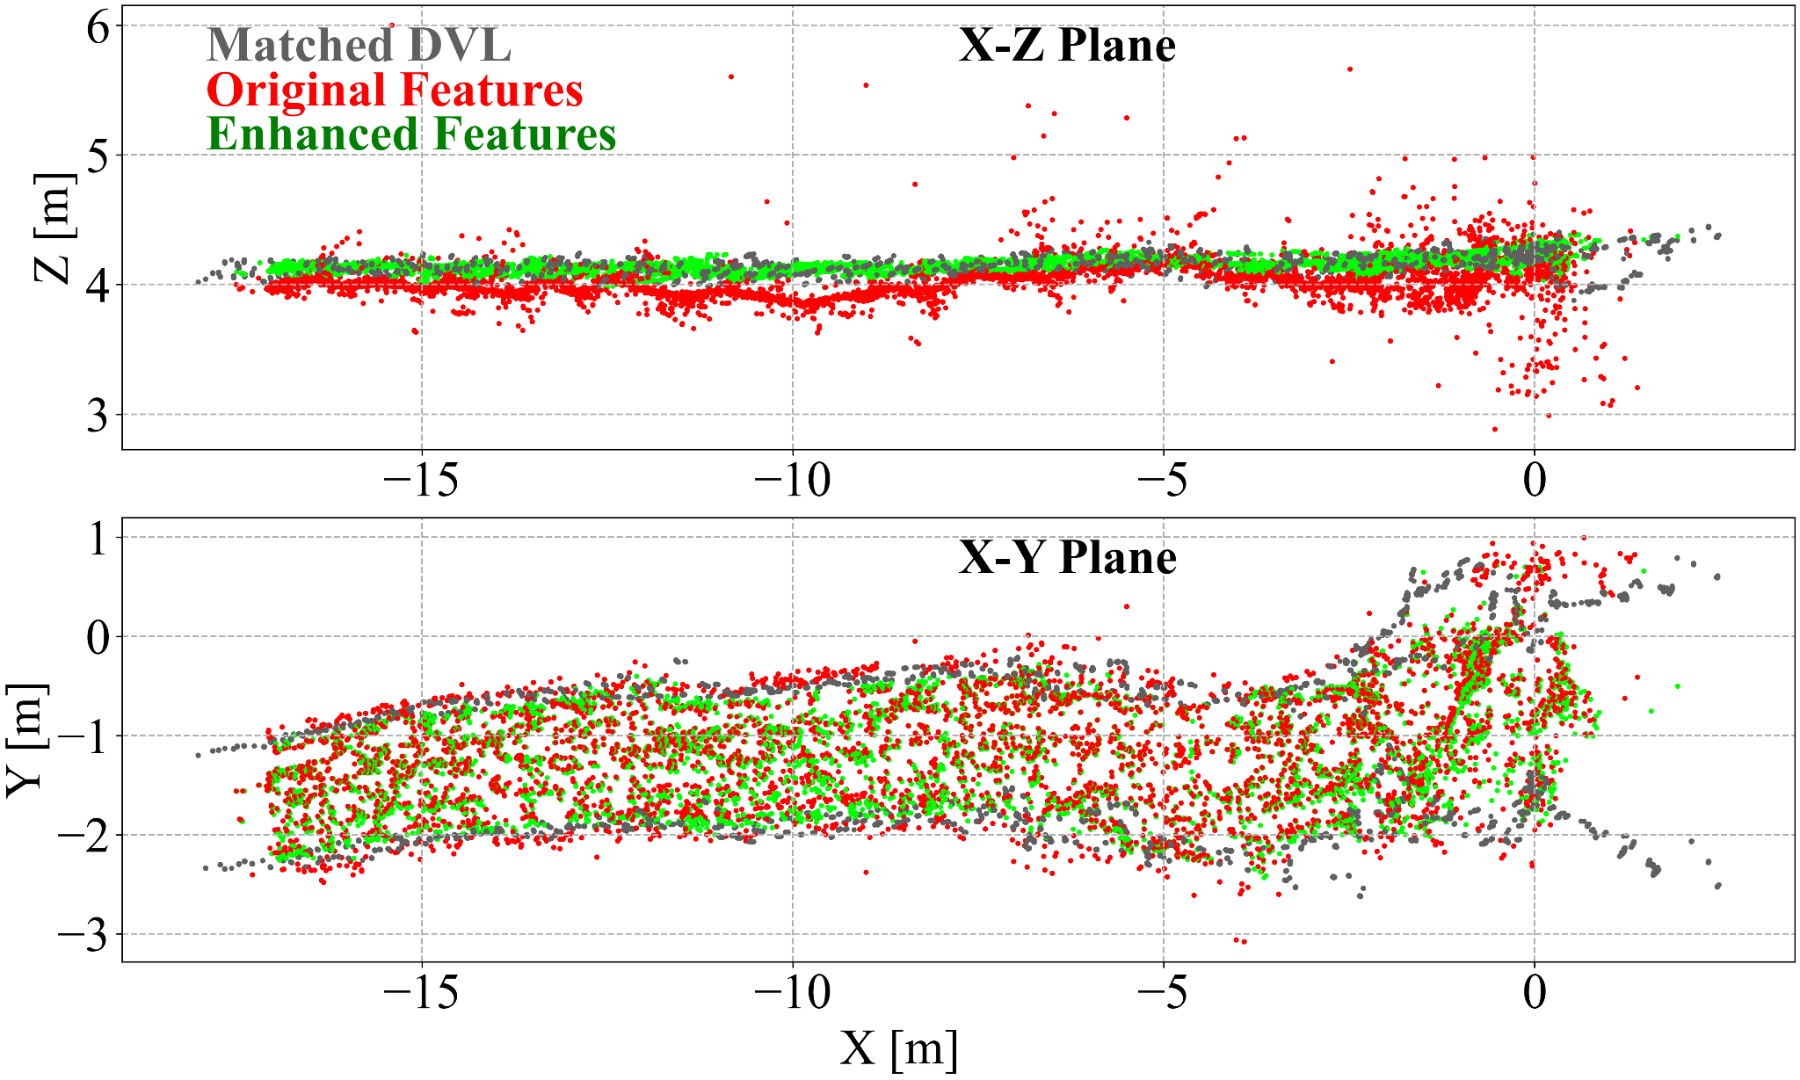
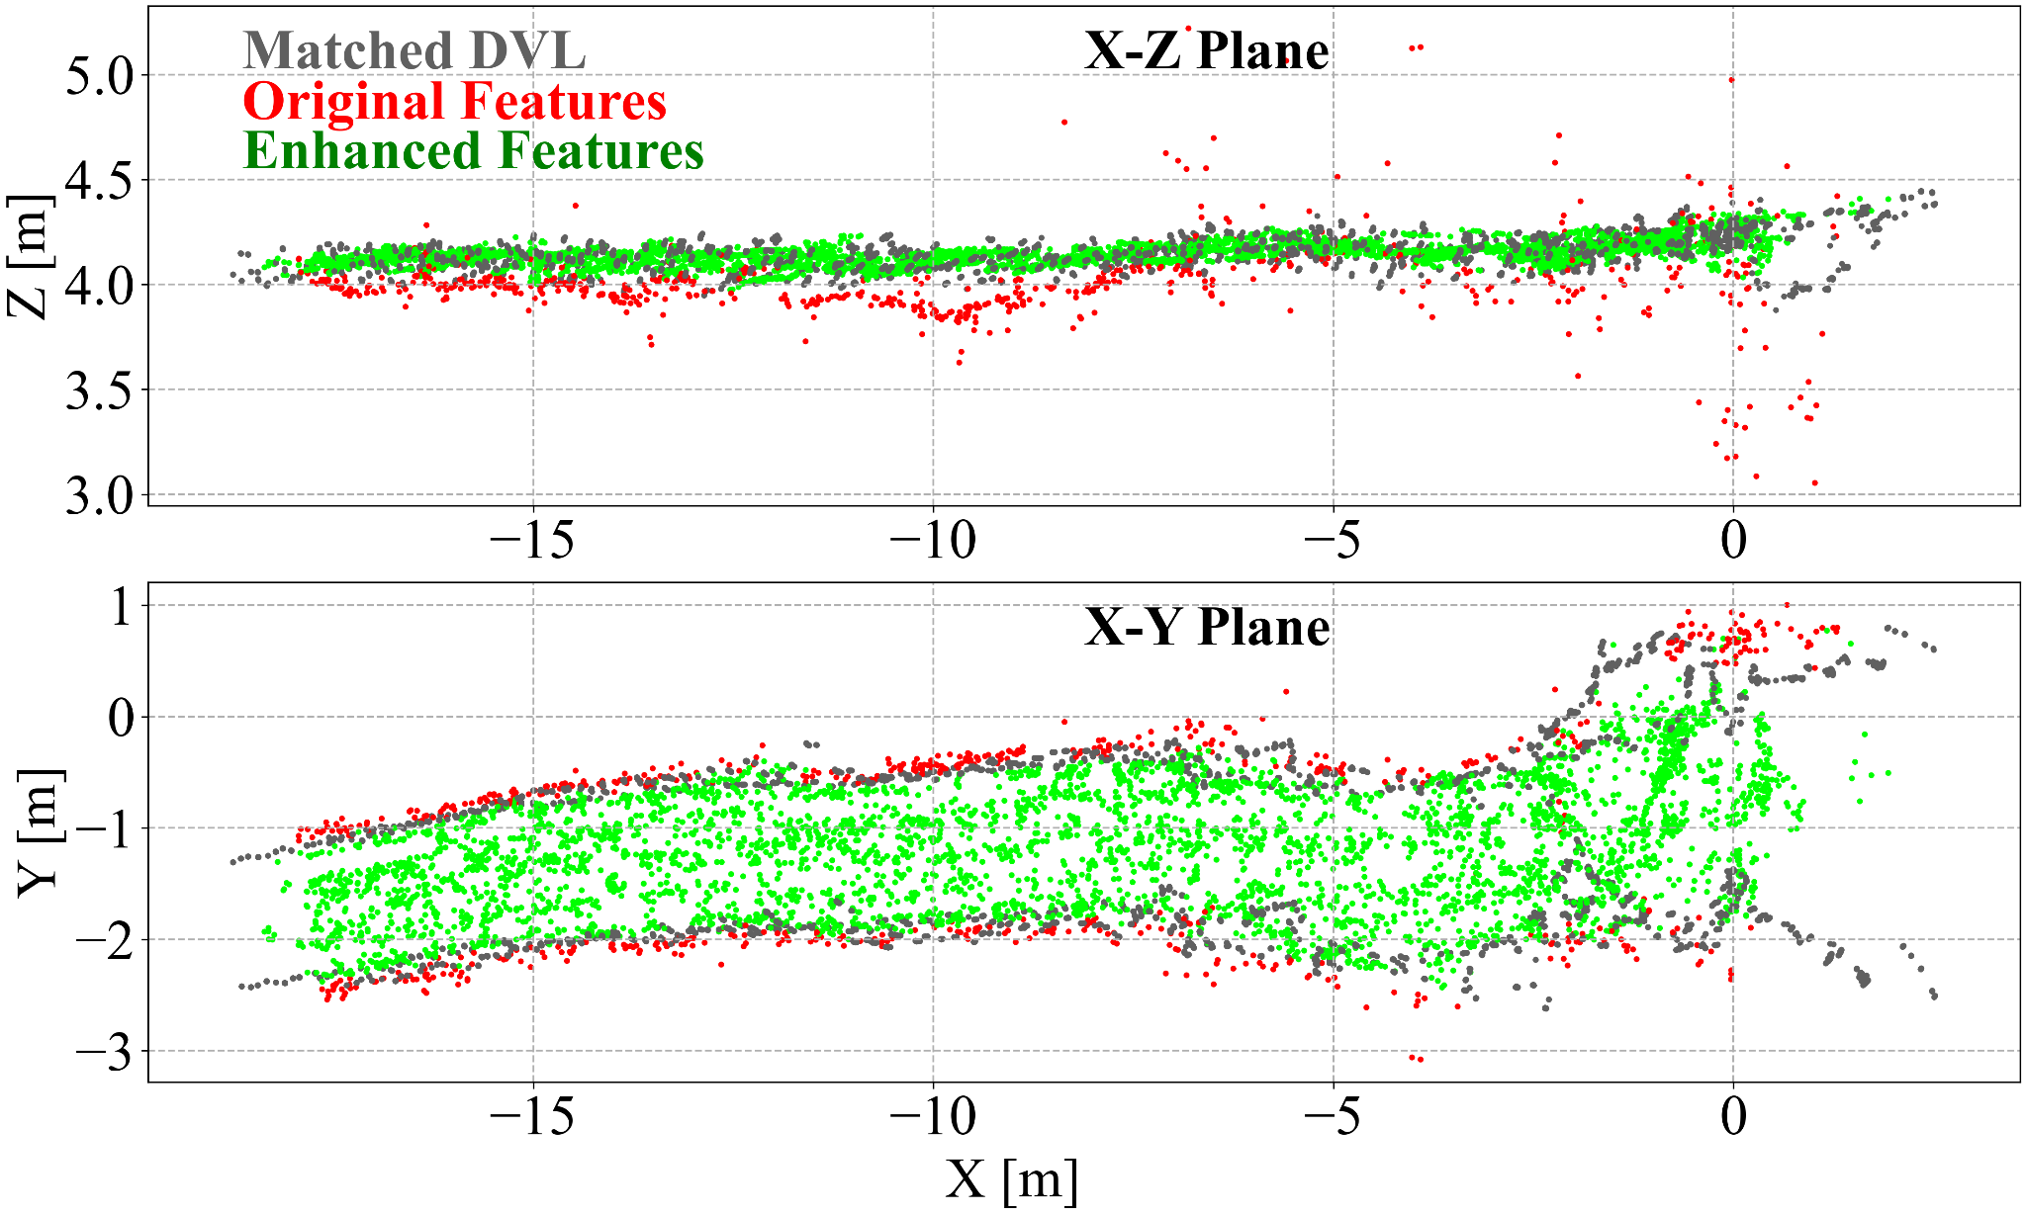
Enhanced Features Result:
(a) Original and enhanced features
(b) Matched and unmatched features
Enhanced features align with DVL point cloud
Most of features can be enhanced by DVL
6
Notes:
For the enhanced features result
Figure (a) shows original and enhanced features visualized in Red and Green, we can see the Enhanced features align with DVL point cloud, which is roughly a plane
Figure (b) shows matched and unmatched features visualized in Red and Green, we can see most of features can be enhanced by the DVL

Slide 7
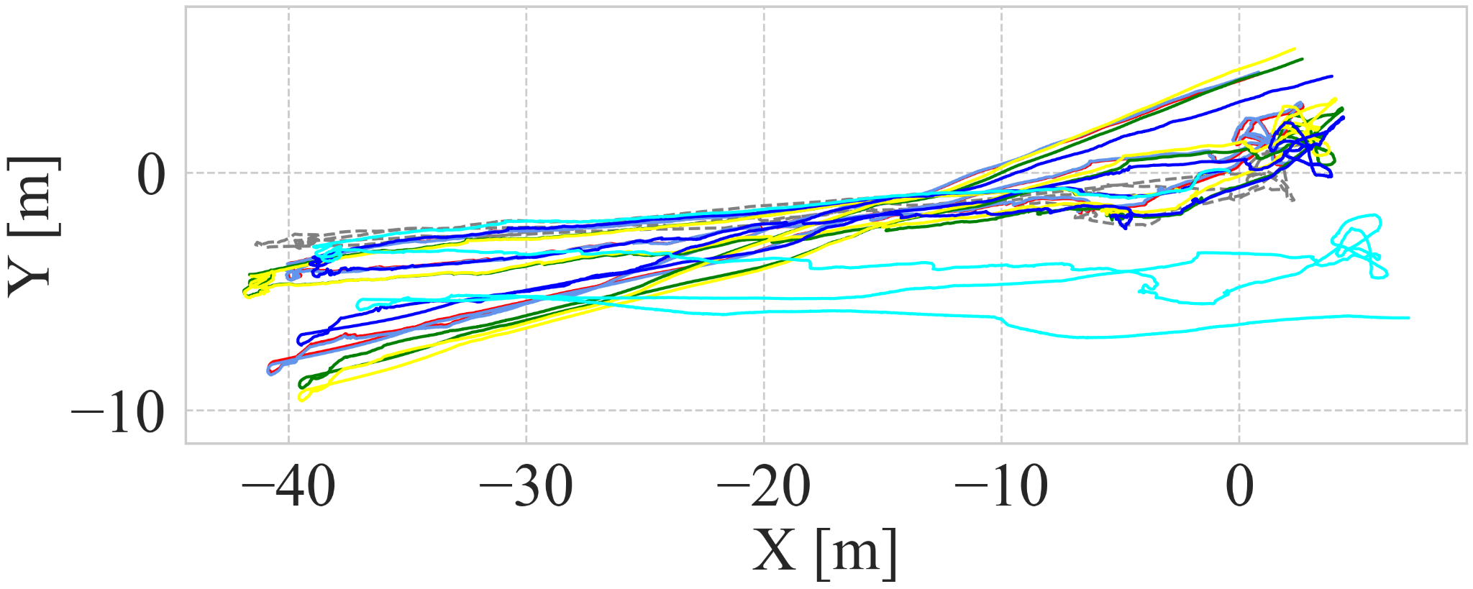
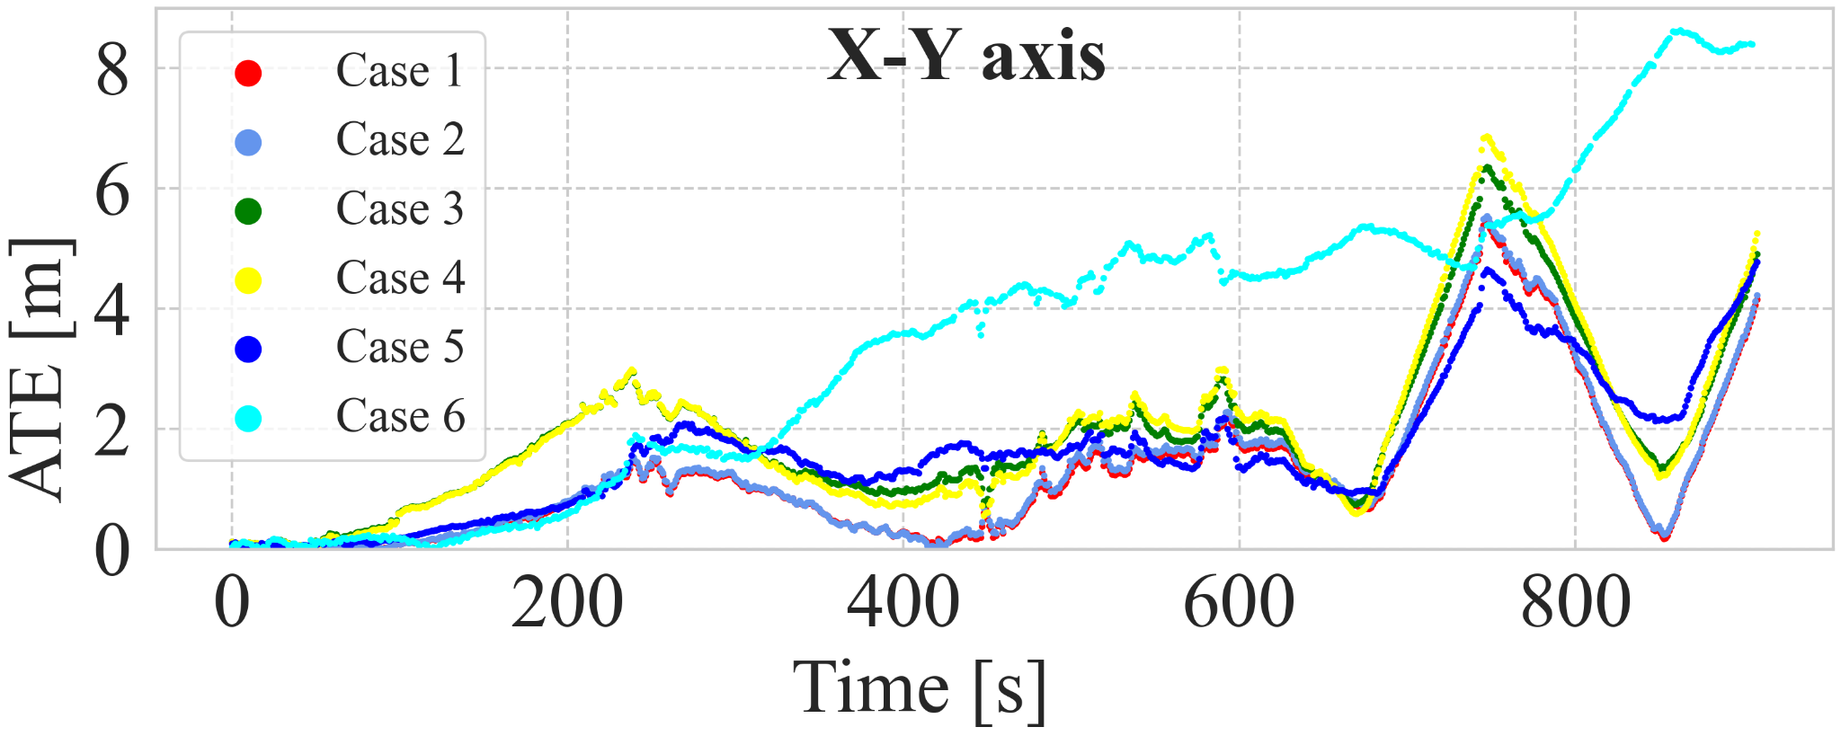
Localization Result:
(a) Sensors setup
(c) The aligned trajectories for case 1 to case 6
(b) ATE with RMSE metric
(d) The ATE translation RMSE for X-Y axis
7
Notes:
For the localization result,
We compared several configurations with enable/disable the sensors, enhancement and keyframe with nearly 20 minutes underice dataset
The aligned trajectories are shown here, case 7-10 are failed because no DVL velocity used
From the RMSE of all trajectories, our proposed method get the best performance

Slide 8
Conclusion & Future Work
The proposed work:
Keyframe marginalization improved the performance
DVL enhanced the feature estimation and increased the accuracy
Future:
Test other state-of-art methods and different underwater datasets
Reduce the drift using loop-closure
8
Notes:
For the conclusion, the proposed work shows
In the future, we will….

Slide 9
Questions ?
linzhao@uri.edu
Lin Zhao
Code
9
Lin Zhao
linzhao@uri.edu
Notes:
I am open to ask questions, thank you !

